Slide 1
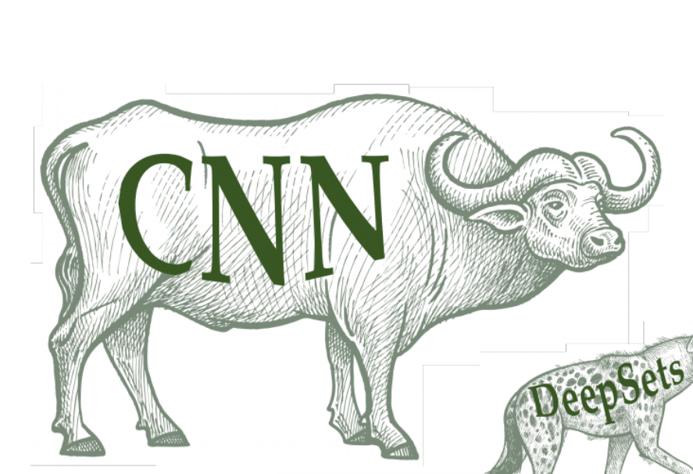

CS 7180: Geometric Deep Learning
Lecture 3: Convolutional Neural Networks
Image credit: Michael Bronstein

Slide 2
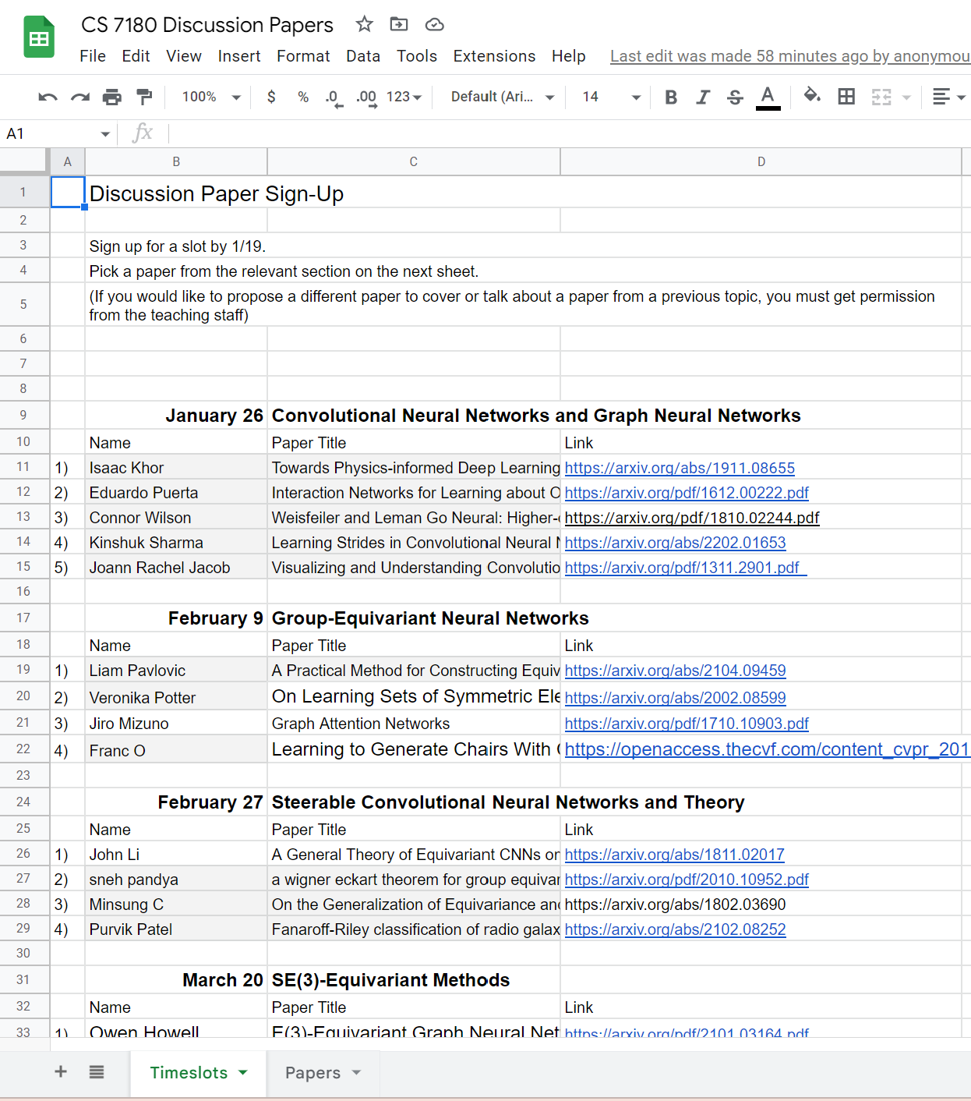
Course Logistics: Paper Presentations
20 minute polished presentation (including questions)
Sign up by end of today!
Start a thread on piazza with at least 3 discussion questions on piazza at least 48 hours in advance.
Everyone is required to participate in the discussion. Please read at least one of the papers and post on piazza in response to one of discussion questions or contribute comment on a strength of the paper, weakness, future extension, or question about the paper.
The expectation is you pick a paper on from that day’s topic. If you want to pick a different paper then you need to get permission.

Slide 3
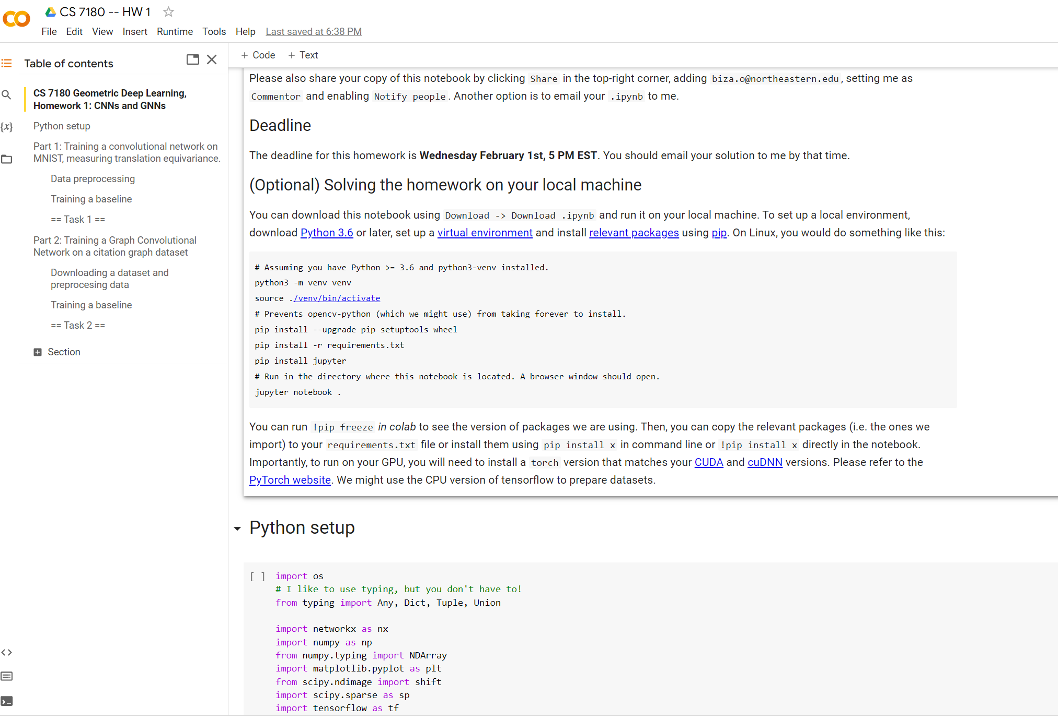
Course Logistics: Homework 1
Thanks Ondrej for preparing HW1 as a collab notebook.
Deadline Wednesday February 1, 5:00PM
Share code and email latexed write up
Study invariance properties of CNNs and GNNs

Slide 4
Convolutional Neural Networks

Slide 5

Task: object recognition
Rose
discriminative mapping from image to object identity

Slide 6
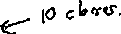
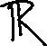
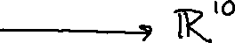
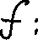
Task: object recognition
Rose
discriminative mapping from image to object identity

Slide 7
How to perform this task with an MLP?

Slide 8

reshape
1
How to perform this task with an MLP?
128 x 128 x 3
49152
49152
Flatten into large vector

Slide 9
reshape
1
How to perform this task with an MLP?
128 x 128 x 3
49152
49152
Flatten into large vector
3 problems…

Slide 10

1. Flattening the image destroy the spatial relationships in the data.
⋮
+
⋮
input image
input vector
Image credit: Michael Bronstein

Slide 11
1. Flattening the image destroy the spatial relationships in the data.
If we shift the image slightly, the same pattern will be processed by completely different weights. This means that we
Need to see the same image over and over in training data in different positions to train the network to identify it.
⋮
+
Image credit: Michael Bronstein

Slide 12
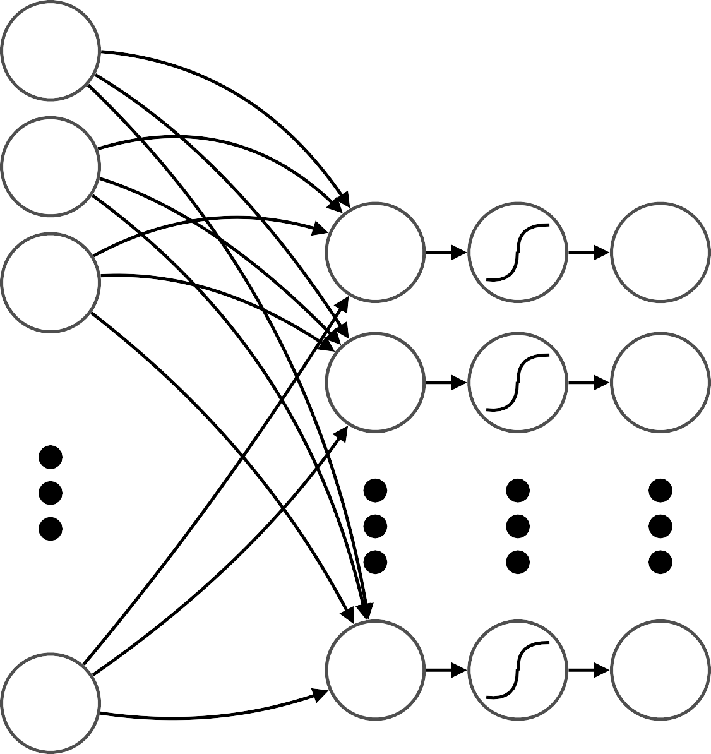
INPUT
2. Number of Weights
how many parameters do we need?
x₁
⌃
x₂
49,152
⌃
10,000
⌃
x_{M}

Slide 13
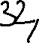
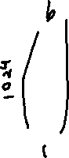
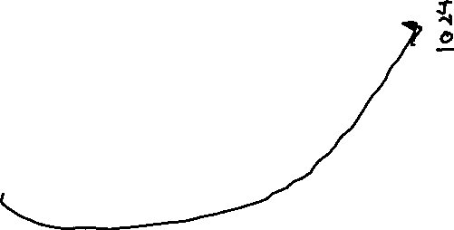
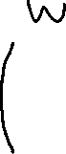
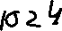
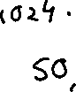
INPUT
2. Number of Weights
how many parameters do we need?
x₁
⌃
x₂
49,152
⌃
1,024
⌃
x_{M}
if we want to recognize even a few basic patterns at each location, very large number of parameters for just the first layer!

Slide 14
3.Resolution-Dependence and Scaling Laws
The number of weights in an MLP will scale at least linearly (and more likely quadratically) in the input resolution.
Since the resolution of the input determines the weight matrix size, the input resolution must be fixed in advance.

Slide 15
to reduce the amount of learning,
we can exploit the spatial structure of image data

Slide 16








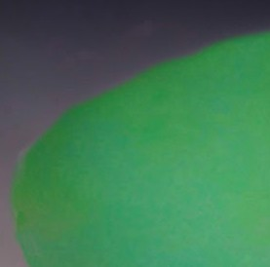



Locality
nearby areas tend to contain stronger patterns
nearby pixels tend to be similar and vary in particular ways
nearby patches tend to share characteristics and are combined in particular ways
nearby regions tend to be found in particular arrangements

Slide 17




Translation Invariance
relative (rather than absolute) positions are relevant
Rose is independent of absolute location of its pixels

Slide 18


let’s translate locality and translation invariance into inductive biases
inputs can be restricted to regions
locality
nearby areas tend to contain stronger patterns
⌃
maintain spatial ordering
same filters can be applied throughout the input
translation invariance
relative positions are relevant
⌃
⌃
same weights

Slide 19




these are the inductive biases of convolutional neural networks
special case of standard (fully-connected) neural networks
⌃
⌃
weight savings
fully-connected
convolutional
(different weights)
(same weights)
⌃
weight savings
⌃
⌃
⌃
fully-connected
convolutional
these inductive biases make the number of weights independent of the input size!

Slide 20
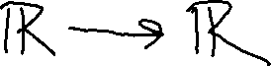
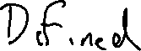
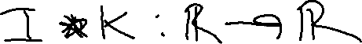
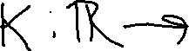
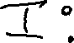
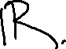
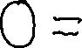
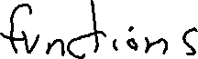
Convolution

Slide 21
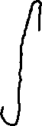
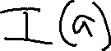
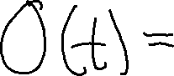
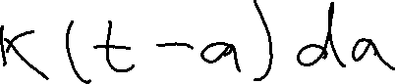
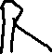
Convolution

Slide 22

Convolution

Slide 23

Convolution

Slide 24
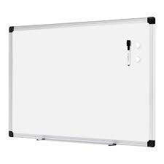
Whiteboard 1: Discrete Convolution

Slide 25
Whiteboard 2: Convolution over R^{n},Z^{n}

Slide 26
Whiteboard 3: Commutativity of Convolution

Slide 27
Whiteboard 4: Cross-Correlation – Convolution with a flipped kernel

Slide 28
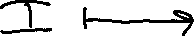
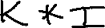
Convolutions are operators; Images are functions
Convolutions are operators which send functions to new functions

Slide 29
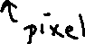
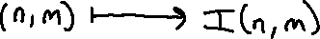
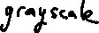
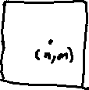
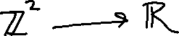
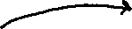
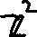
Convolutions are operators; Images are functions
Convolutions are operators which send functions to new functions
We think of images a functions

Slide 30

Convolutions are operators; Images are functions
Convolutions are operators which send functions to new functions
We think of images a functions
For (n,m) outside the image boundary, we choose what to do. For example return 0, i.e. zero padding.

Slide 31
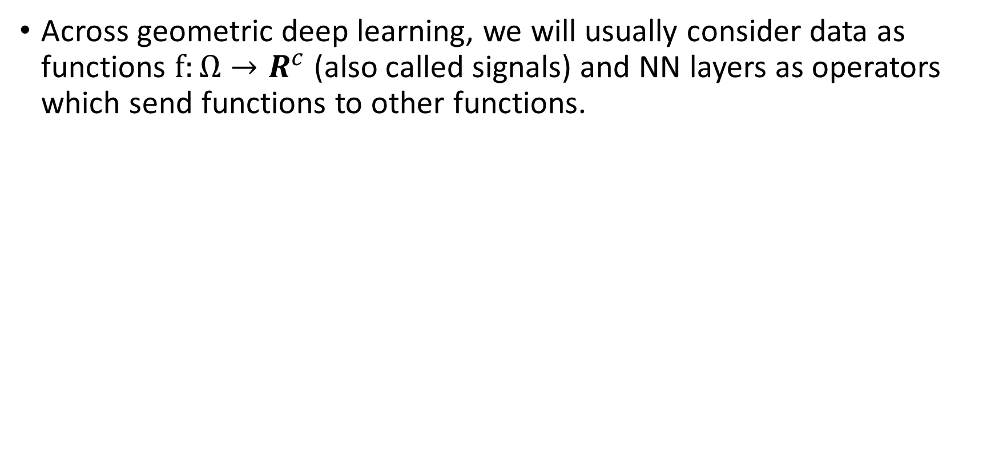
Convolutions are operators; Images are functions
Across geometric deep learning, we will usually consider data as functions $f:Ω→R^{c}$ (also called signals) and NN layers as operators which send functions to other functions.

Slide 32
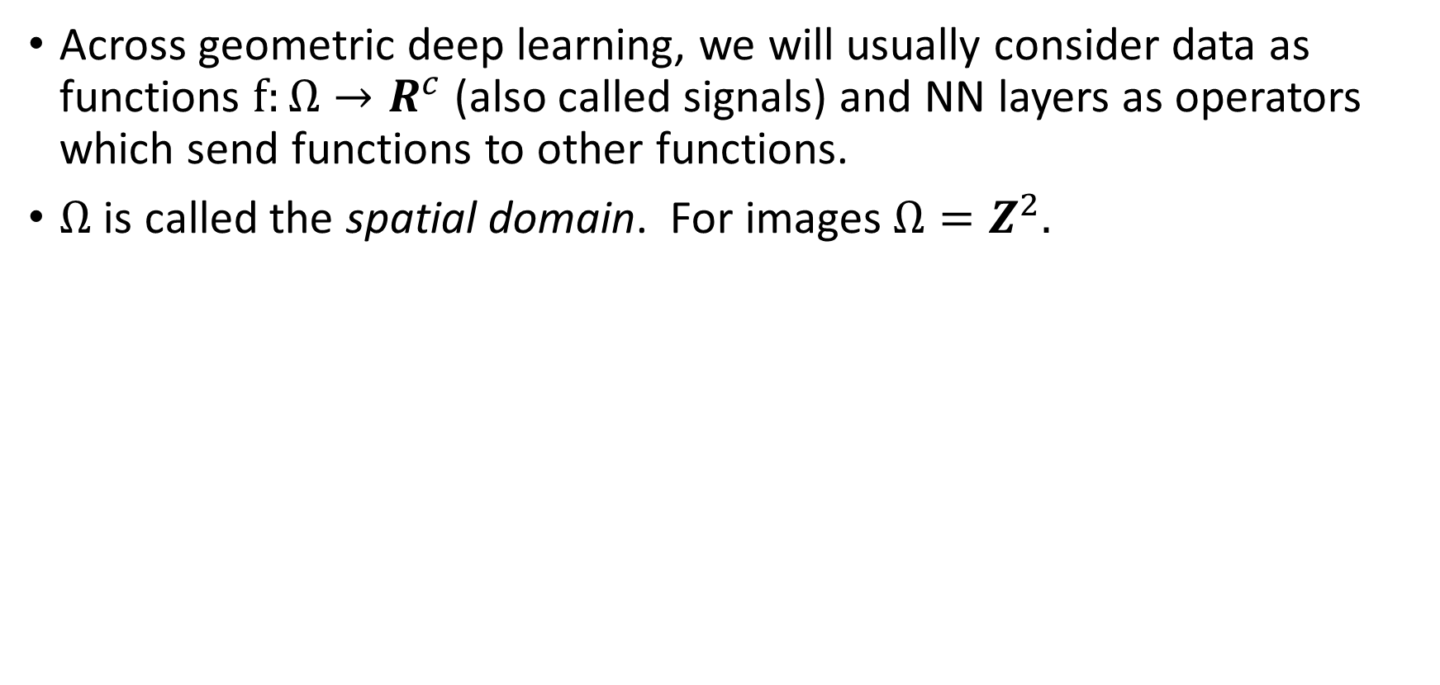
Convolutions are operators; Images are functions
Across geometric deep learning, we will usually consider data as functions $f:Ω→R^{c}$ (also called signals) and NN layers as operators which send functions to other functions.
$Ω$ is called the spatial domain. For images $Ω=Z^{2}.$

Slide 33
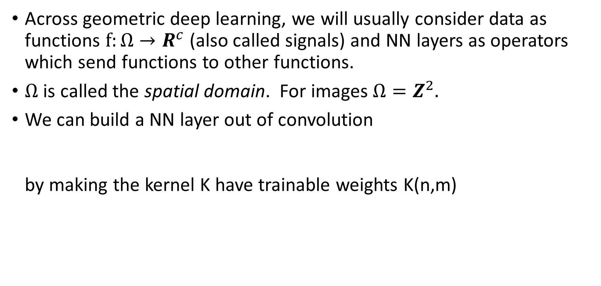
Convolutions are operators; Images are functions
Across geometric deep learning, we will usually consider data as functions $f:Ω→R^{c}$ (also called signals) and NN layers as operators which send functions to other functions.
$Ω$ is called the spatial domain. For images $Ω=Z^{2}.$
We can build a NN layer out of convolution by making the kernel K have trainable weights K(n,m)

Slide 34
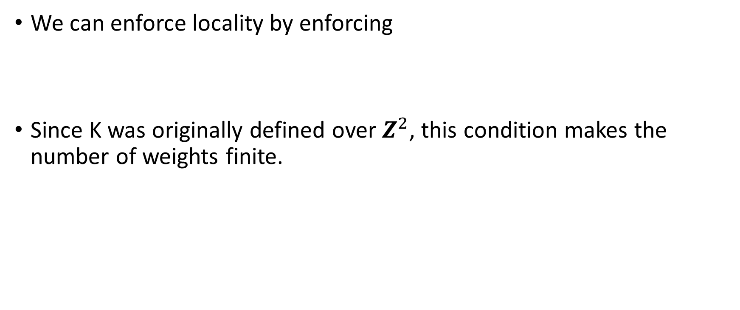
Enforcing locality
We can enforce locality by enforcing
Since K was originally defined over $Z^{2}$, this condition makes the number of weights finite.

Slide 35
Enforcing locality
We can enforce locality by enforcing
Since K was originally defined over $Z^{2}$, this condition makes the number of weights finite.

Slide 36
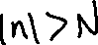
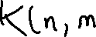
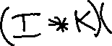
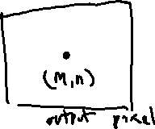
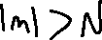
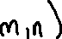
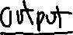

Enforcing locality
We can enforce locality by enforcing

Slide 37
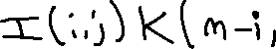


Enforcing locality
We can enforce locality by enforcing

Slide 38


Enforcing locality
We can enforce locality by enforcing

Slide 39






Enforcing locality
We can enforce locality by enforcing

Slide 40

Enforcing locality
We can enforce locality by enforcing

Slide 41



Enforcing locality
We can enforce locality by enforcing

Slide 42

Enforcing locality
We can enforce locality by enforcing
≤≤≤
So each output pixel only depends on / is connected to input pixels ≤ N away in $∞$ Norm

Slide 43
Whiteboard 5: Images as functions; Neural network layers as convolution

Slide 44


Convolution
filter weights:
take inner (dot) product of filter and each input location
measures degree of filter feature at input location
feature map
http://deeplearning.net/software/theano_versions/dev/tutorial/conv_arithmetic.html

Slide 45




Understand Linear Filter
No change
Left shift by 1 pixel
Blurring filter
Sharping filter

Slide 46

Padding
typically add zeros around the perimeter to preserve spatial size
http://deeplearning.net/software/theano_versions/dev/tutorial/conv_arithmetic.html

Slide 47

Stride
stride = 2
only compute output at some integer interval to downsample
http://deeplearning.net/software/theano_versions/dev/tutorial/conv_arithmetic.html

Slide 48
filters are applied to all input channels
3 x 3 x 3 filter tensor
channel 3
channel 2
channel 1
filter size
padding size
stride size
each filter results in a new output channel

Slide 49






Pooling
locally aggregates values in each feature map
downsampling and invariance
can be applied with padding and stride
predefined operation: maximum, average, etc.

Slide 50








Shift Equivariance

Slide 51
Whiteboard 6: Shifting Images

Slide 52
Whiteboard 7: Convolution is shift equivariant

Slide 53
Whiteboard 8: Convolution is linear

Slide 54

Mathematica 1: Toeplitz Matrix of the Convolution

Slide 55
Mathematica 2: Convolution is the unique shift-equivariant local linear operation

